Slide 1
Okta/Sentry Support
R1 Learning Suite
  Password reset
  MFA Factor reset
  Unlock my OLB profile

Slide 2

Intro slide with the digital program branding
The digital program brand image appears
How to reset a password in Okta/Sentry
If there is a digital program brand chime it should sound as the intro image appears
Topic: (ToS) How to reset a password in Okta/Sentry

Slide 3
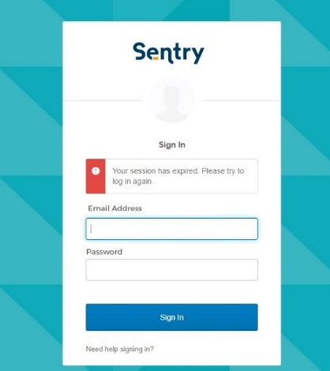
Module title
How to Reset a Password
Title appears
Voice over script
Voice over: Welcome to how to reset a password. There are five steps to resetting a user’s password.

Slide 4
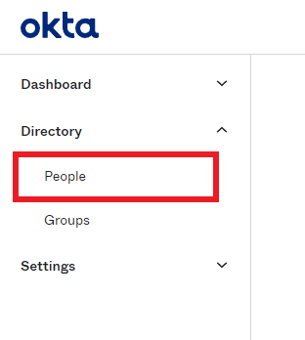
Step 1 in how to reset a password
Either a static image with arrow animations, text on screen and voiceover or motion graphic
Voice over
Voice over: To reset a user’s password first sign into the Okta Administration portal then go to the directory and select “people” from the menu on the left side of the window

Slide 5
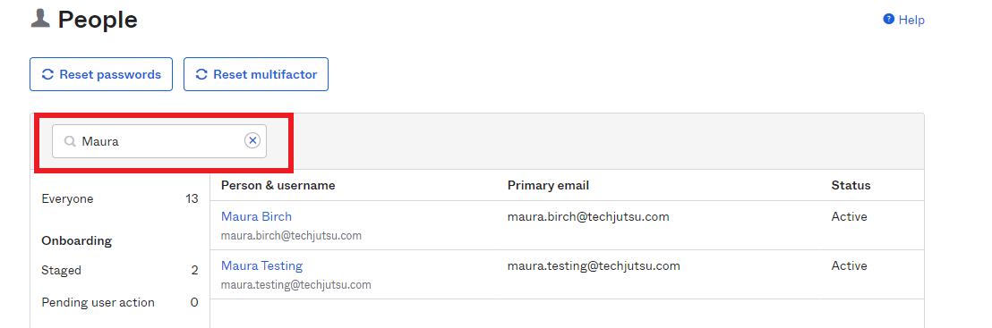
Step 2 in how to reset a user’s password
Either a static image with arrow animations, text on screen and voiceover or motion graphic
Voice over
Voice over: Search for the name of the user whose password you are going to reset

Slide 6
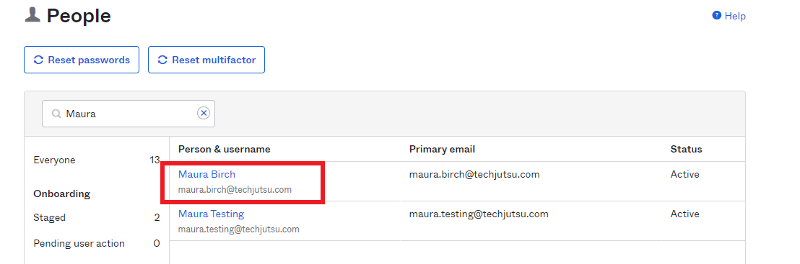
Step 3 in how to reset a user’s password
Either a static image with arrow animations, text on screen and voiceover or motion graphic
Voice over
Voice over: Select the user’s name from the search results

Slide 7
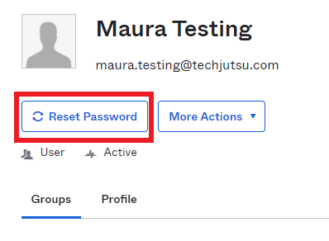
Step 4 in how to reset a user’s password
Either a static image with arrow animations, text on screen and voiceover or motion graphic
Voice over
Voice over: Select the “reset password” button on the user’s profile

Slide 8
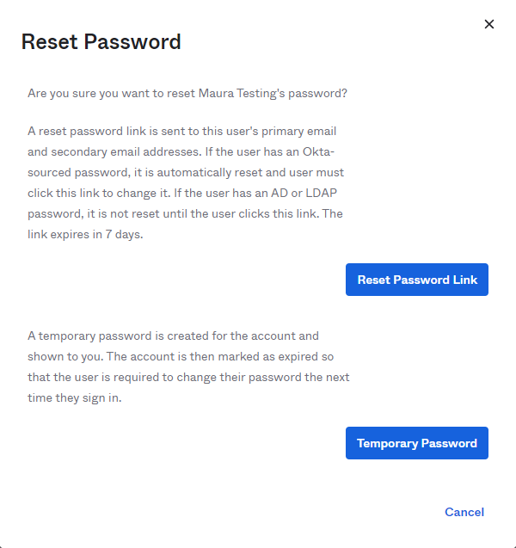
Step 5 in how to reset a user’s password
Either a static image with arrow animations, text on screen and voiceover or motion graphic
Voice over
Voice over: A pop up with two options will appear. Options one is to send a reset password link to the user, option two is to create a temporary password for the user. Choose the option that works best for the person calling in for help. To send a rest password link first select the reset password button a password reset link will be automatically sent to the user’s primary e-mail address. To create a temporary password, select the temporary password button; a temporary password will be created and shown to the support person to then share with the user.

Slide 9
Title slide
How to Reset a User’s MFA
Title appears
Voice over script
Voice over: Welcome to how to reset a user’s multi-factor authentication. If a user has replaced their mobile device, they may need to reset their multi-factor authentication. There are five steps to rest a user’s multi-factor authentication.

Slide 10
Step 1 in how to reset a user’s MFA
Either a static image with arrow animations, text on screen and voiceover or motion graphic
Voice over
Voice over: To rest a user’s multi-factor authenitication first sign into the Okta Administration portal then go to the directory and select “people” from the menu on the left side of the window

Slide 11
Step 2 in how to reset a user’s MFA
Either a static image with arrow animations, text on screen and voiceover or motion graphic
Voice over
Voice over: Search for the name of the user who needs their multi-factor authentication reset.

Slide 12
Step 3 in how to reset a user’s MFA
Either a static image with arrow animations, text on screen and voiceover or motion graphic
Voice over
Voice over: Select the user’s name from the search results

Slide 13
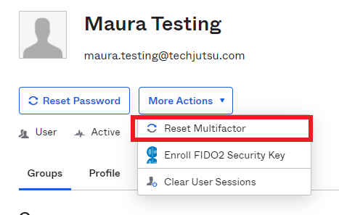
Step 4 in how to reset a user’s MFA
Either a static image with arrow animations, text on screen and voiceover or motion graphic
Voice over
Voice over: Select the “more actions” button and then select the “ reset multifactor” button from the user menu. Then select one ore more MFA factors to reset.

Slide 14
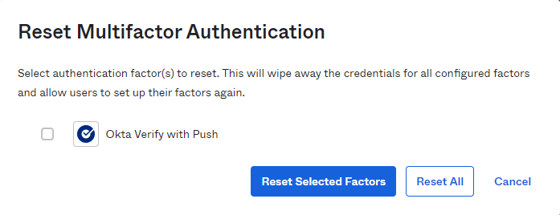
Step 5 in how to rest a user’s MFA
Either a static image with arrow animations, text on screen and voiceover or motion graphic
Voice over
Voice over: Select the “reset selected factors” button to reset the chosen factors. Optionally you may use the “reset all” button if you are resetting all the user’s factors in one single operation

Slide 15
Title slide
How to Unlock a User’s Account
Title appears
Voice over script
Voice over: Welcome to how to unlock a user’s account. A user may be locked out of their account if they have entered the wrong password too many times. There are 5 steps in unlocking a user’s account.

Slide 16
Step 1 in how to unlock a user’s account
Either a static image with arrow animations, text on screen and voiceover or motion graphic
Voice over
Voice over: To unlock a user’s account first sign into the Okta Administration portal then go to the directory and select “people” from the menu on the left side of the window

Slide 17
Step 2 in how to unlock a users account
Either a static image with arrow animations, text on screen and voiceover or motion graphic
Voice over
Voice over: Search for the name of the user whose has been locked out of their account

Slide 18
Step 3 in how to unlock a users account
Either a static image with arrow animations, text on screen and voiceover or motion graphic
Voice over
Voice over: Select the user’s name from the search results

Slide 19
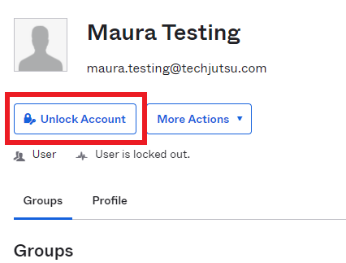
Step 4 in how to unlock a user’s account
Either a static image with arrow animations, text on screen and voiceover or motion graphic
Voice over
Voice over: Select the “unlock account” button from the user’s profile

Slide 20
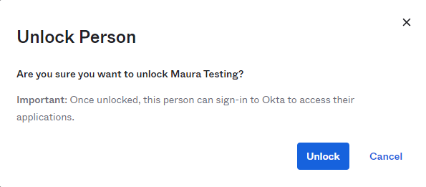
Step 5 in how to unlock a user’s account
Either a static image with arrow animations, text on screen and voiceover or motion graphic
Voice over
Voice over: A pop up will appear asking you to confirm the unlock operation. Select the “unlock” button to confirm the operation and unlock the user’s account

